Slide 1

Accuracy, Recall or Explainability?
A Case Study in Predicting Readmission for Diabetes
STA2453
Sanghamesh S Vastrad
Joseph Roussy

Slide 2
Agenda
Problem Introduction
Exploratory Data Analysis
Feature Engineering and Modeling (Iterations)
Model Explainability & Suggestions
Takeaways

Slide 3
Problem in Hand
Dataset
Represents 10 years (1999-2008) of clinical care at 130 US hospitals
Attributes such as age, admission type, discharge disposition, medication, etc along with information about readmission of either ‘NO’, ‘<30’ days or ‘>30’ days.
Questions we want to answer
Predict short term risk (30 day window) of readmission
Predict overall/long-term risk (<30 or >30 days)
Explain our model so that discharges can we handled better, to reduce readmission

Slide 4
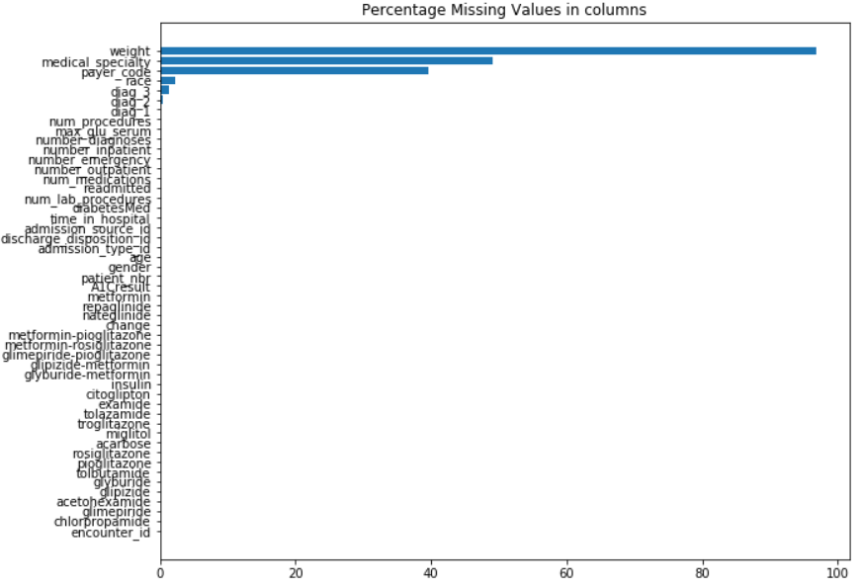
Exploratory Data Analysis
No timestamp → Can not perform any kind of time series analysis → Restricts the new features we can come up with
Some columns are really sparse → Best to remove these as we do not have domain knowledge.

Slide 5
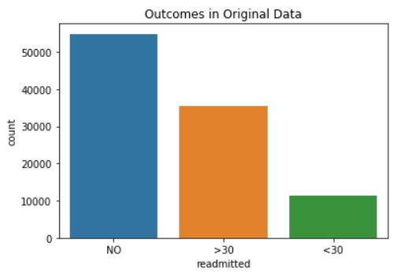
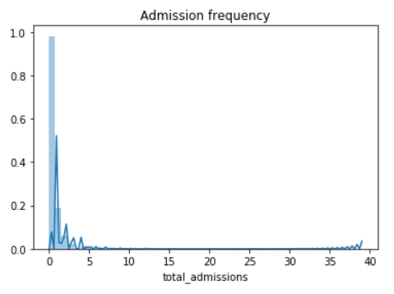
Exploratory Data Analysis
Although the original data seems quite well balanced, there are patients readmitted more than once.
Need to remove multiple readmissions to make data i.i.d, but have some feature capture information on occurrences.

Slide 6
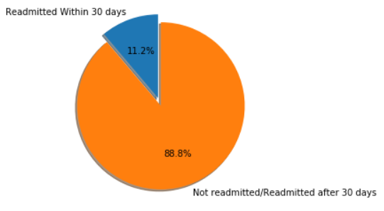
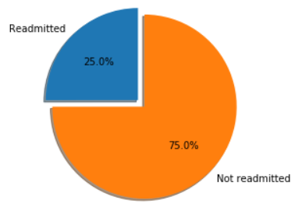
Data Imbalance
Short term risk prediction
Long term/Overall risk prediction

Slide 7
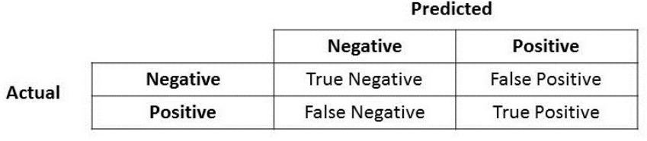
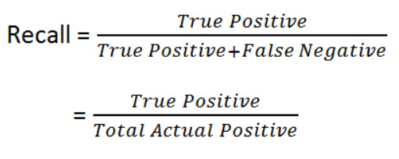
Accuracy or Recall?
When there is data imbalance, is accuracy the measure by which we judge our model?
Since our goal is to predict readmission, we need to tailor our model evaluation to this goal. That means we want to focus on high recall primarily and also high precision.

Slide 8
Points to note before moving forward
Multiple readmissions of same patients needs to be removed.
This can lead to data imbalance.
Accuracy is not a good measure when there is data imbalance.
If data after cleaning has 5% positive cases and 95% negative cases, and a model predicts all outcomes as negative, accuracy is still 95%!

Slide 9
Feature Engineering and Modeling - Step 1
Feature Engineering
Simple for first iteration
Coded categorical variables and assigned quantitative values to dosages
Grouped Diagnoses
Need i.i.d. dataset for Logistic Regression and XGBoost
Only take last visit for each patient
Modeling
Started with short term risk models
Wanted to start off with default Logistic Regression and XGBoost as baselines
Explore how to address class imbalance
Class weighting
Oversampling (SMOTE)
Undersampling
Notes:
Iterative process to feature engineering and modeling
Standard coding for variables
Grouped diagnosis codes into classes such as Circulatory or Respiratory etc.
Created and i.i.d. Dataset by taking the last admission for each patient
Trained simple baseline models
Tried different methods of dealing with class imbalance and class weighting performed the best
Class weighting increases the magnitude of parameter adjustments for the minority class because we have less examples of them. A good default value is the ratio of negative to positive class examples.

Slide 10
Feature Engineering and Modeling - Step 1
Quantitative Dosage Coding
Up → 10
Down → -10
Steady → 0
No → -200

Slide 11
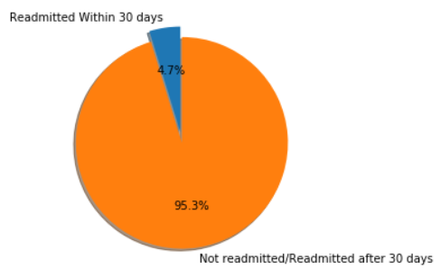
Data Imbalance
Removing duplicate readmissions from same patient exacerbates class imbalance
Notes:
Discuss how removing duplicate visits makes the data more imbalances.
Now only 4.7% vs 11.2%

Slide 12
Feature Engineering and Modeling - Step 2
Feature Engineering
Experimented with one hot encoding for each dosage change for each drug
Decreased performance
Created some new features
Medication dosage changes
Total admissions
Leave in missing values for XGBoost
Removed patients who died
Modeling
Found that class weightings affects recall
Higher positive class weighting trades higher recall for lower accuracy
Experimented with complex XGBoost models vs more simple configurations
Simple models with high positive class weight gives best recall
Grid search with 3-fold CV for optimal parameters using ROC AUC as the evaluation metric. Training data = 70% total data
Notes:
Created some new features
Number of medication dosage changes for a given admission
Total admissions for a given patient across the entire dataset so we are not losing all the information encoded in the duplicate visits
Removed patients who died because they cannot be later readmitted
Found that using the recommended ratio for positive class weight tends to give us higher recall
Found overly complex XGBoost models performed poorly even when we used the regularization parameters
Ran a 3-fold cross validation grid search for XGBoost hyperparameters but we used ROC AUC as the evaluation metric so we ended up with a model that had high ROC AUC but low recall

Slide 13
Feature Engineering and Modeling - Step 3
Feature Engineering
Grouped null categories for admission and discharge
Helped model
Tried grouping categories of discharge and admission
Hurt model
Takeaway: need domain knowledge to engineer features
Modeling
Previous step found an XGBoost model with high ROC AUC but poor recall
Should be using recall as evaluation metric
Fixed positive weight scale to recommended value and ran grid search with recall as the evaluation metric to get final model
Notes:
Grouped null categories for admission and discharge
Tried further grouping but this hurt the model
Need domain knowledge to engineer relevant features
Ran our grid search again with positive weight scale fixed to ratio of negative to positive training examples and used recall as the evaluation metric

Slide 14
Feature Engineering and Modeling - Grid Search
Model Complexity
Sampling
Parameter | Values
Max Tree Depth | 3, 6, 8
Number of Trees | 100, 300, 500
Learning Rate | 0.3, 0.1, 0.03
Min Child Weight | 1, 3, 5
Parameter | Values
Row Subsample | 0.5, 0.75, 1
Column Sample By Level | 0.5, 0.75, 1
Column Sample By Node | 0.5, 0.75, 1
Column Sample By Tree | 0.5, 0.75, 1
Notes:
Tested different values of relating to model complexity and dataset samping. Made sure to include the default values for each parameters in our grid search to ensure there is value in tuning it

Slide 15
Short Term Risk Model | XGBoost
Parameter | Value
Positive Weight Scale | ~20
Max Tree Depth | 3
Number of Trees | 100
Learning Rate | 0.03
Min Child Weight | 5
Row Subsampling | 1
Column Sampling (all types) | 0.75
Evaluation Metrics
Computed on 30% held out test data
Recall: 0.64
Accuracy
Training: 68.80%
Test: 68.79%
ROC AUC: 0.72
Notes:
Evaluated the final XGBoost model on a held out test dataset
ROC AUC is similar to when we optimized for it directly but recall is much higher

Slide 16
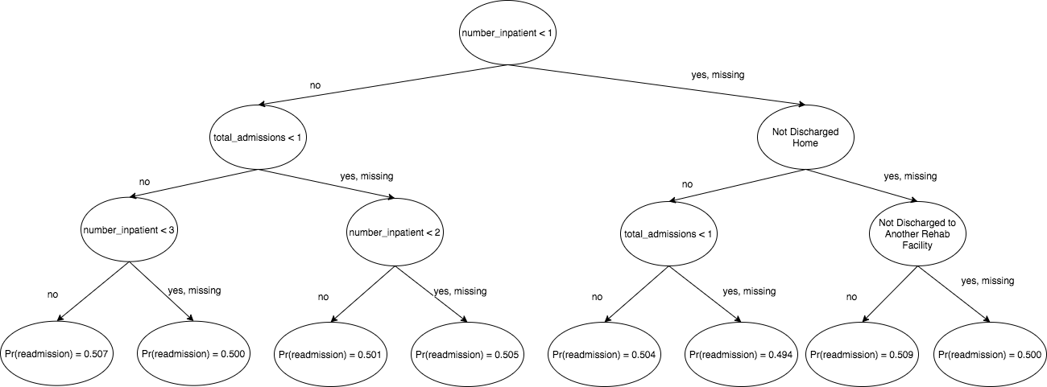
Visualization of First Tree
Notes:
Probabilities are not far from 0.5. This is an example how XGBoost builds up weak classifiers
Certain features are used multiple times (number_inpatient and total_admissions).
We will see later how these are important features for the model

Slide 17
Long Term Risk Model | XGBoost
Parameter | Value
Positive Weight Scale | ~3
Max Tree Depth | 3
Number of Trees | 300
Learning Rate | 0.3
Min Child Weight | 3
Row Subsampling | 1
Column Sampling (node and tree) | 0.5
Column Sampling by level | 0.75
Evaluation Metrics
Computed on 30% held out test data
Recall: 0.65
Accuracy
Training: 66.76%
Test: 66.09%
ROC AUC: 0.72
Notes:
Parameters are quite different from the short term model
Lower accuracy but higher recall than the short terms model
Seems to make sense because there is a general tradeoff on this dataset between recall and accuracy and this prediction class seems easier than short term (more positive examples)

Slide 18
Feature Engineering & Tuning Results
XGBoost
Baseline model (with correct positive scale)
Recall (Short Term): 0.63
Recall (Long Term): 0.62
Final Model
Recall (Short Term): 0.64
Recall (Long Term): 0.65
Logistic Regression
Baseline model (with correct positive scale)
Recall (Short Term): 0.55
Recall (Long Term): 0.62
Final Model
Recall (Short Term): 0.55
Recall (Long Term): 0.62
Correct class scale makes baseline models almost as good as final models!
Notes:
Performance of final model is not that much better than that of baseline models with correct positive weight scale
If we are maximizing recall, setting the positive class scale correctly is the single most important tuning step we can do
All the other tuning and feature engineering gave marginal increases in performance
Feature engineering did not even improve performance on the logistic regression model

Slide 19
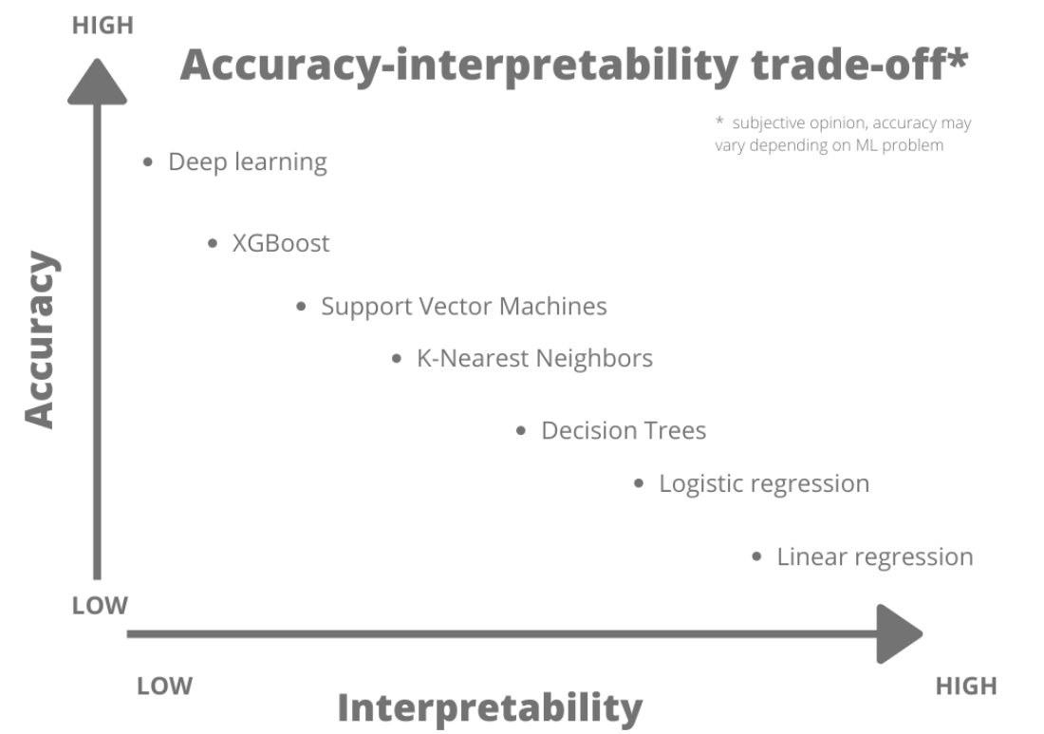
Model Explainability
What features in the data did the model think are most important?
For any single prediction from a model, how did each feature in the data affect that particular prediction?
How does each feature affect the model's predictions in a big-picture sense?

Slide 20
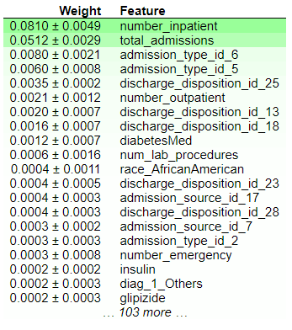
Feature Importance
eli5 library uses permutation importance to calculate feature importance.
Weights returned indicate how much the accuracy of the model would decrease if that particular column was randomly shuffled.
Important to note that our feature - total_admissions - was second on the list for short term risk prediction.

Slide 21
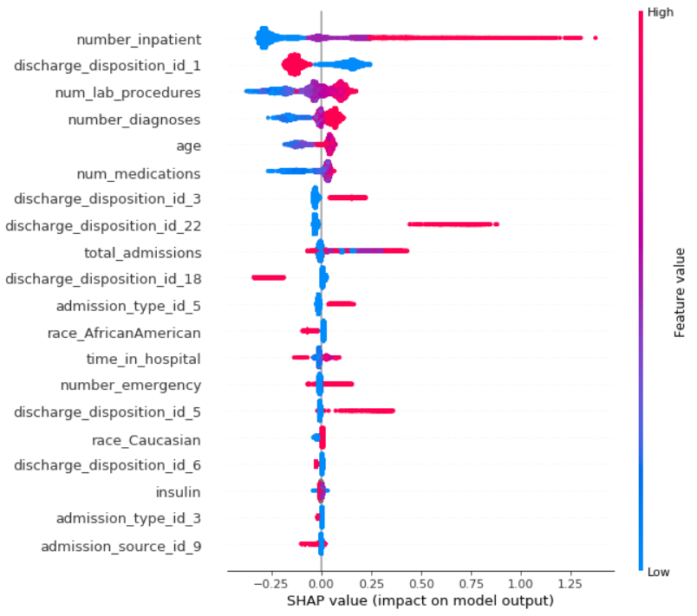
Short term risk prediction
shap library uses game theory to compute not only feature importance, but also shap values, which can be considered equivalent to coefficients in regression.
Model summary picks out important features to show their impact on the model.

Slide 22
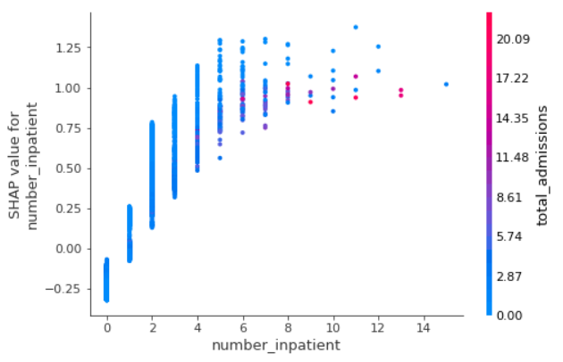
Short term risk prediction
Also allows us to see the effect of each feature on the model predictions.
We can see that as number of inpatient visits over the last year is directly proportional to the patient getting readmitted again within 30 days.
Suggestion: Do not discharge the patients with high number of inpatient visits without thorough examination.

Slide 23
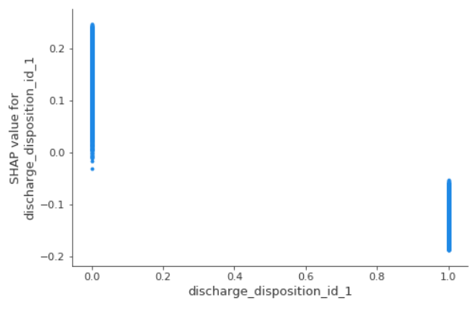
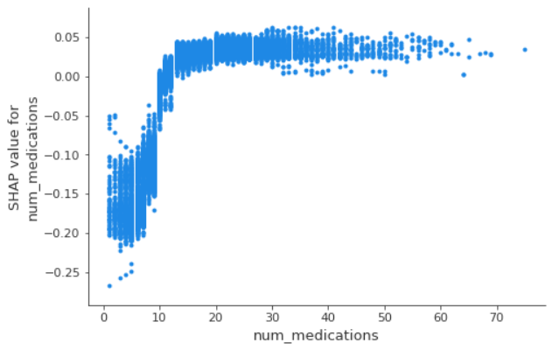
Short term risk prediction
Watch out: Patients discharged to any other centers/place other than home are more likely to get readmitted.
Domain experts to note: Are there ways in which number of medications can be reduced? More than 10-15 medicines seems to suggest higher risk!

Slide 24
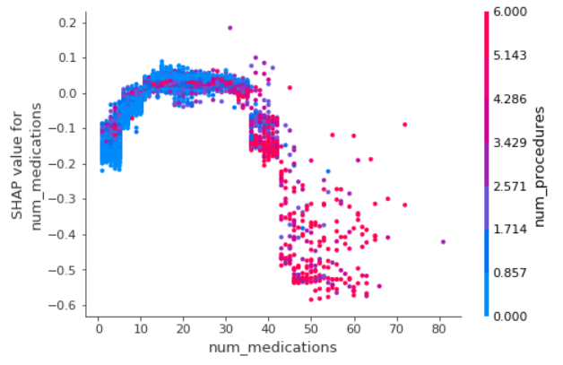
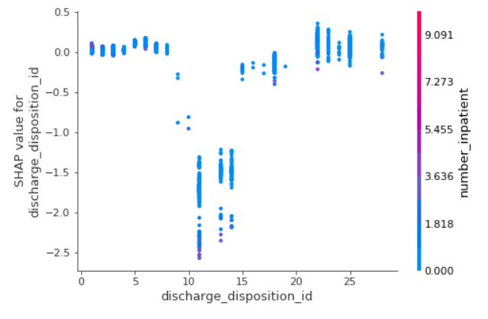
Explainability → Better Features
Bonus: Model explainability can also help in feature engineering!

Slide 25
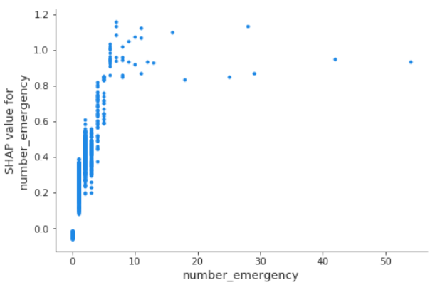
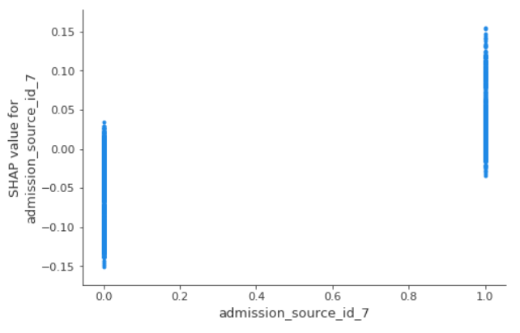
Long term/Overall risk
Possibility: People coming from the emergency room and with more emergency visits have higher risk of returning. Maybe they require additional aid to take care of themselves in the long run.

Slide 26
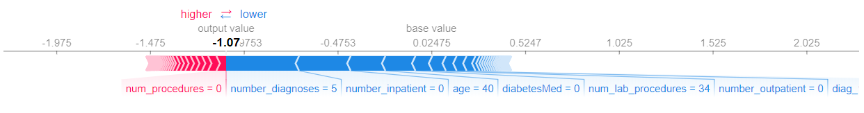
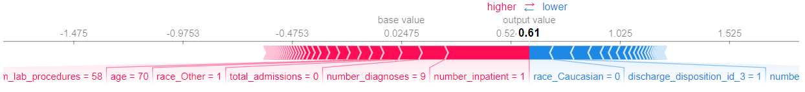
How to access new patients?
Proposed Solution:
Not only classify patients as risky or not risky for discharge, but show doctors the factors driving the prediction towards the higher or lower end.
Act as a aid to doctors before making the final decision.

Slide 27
Conclusion and Improvements
What we learned:
Feature engineering an iterative process.
Imbalanced data requires class weight tweaking to achieve good results.
Classification task shouldn’t be decided on accuracy alone.
Model explainability very important in domains where the decisions have high impact.
How we can improve further:
Ranking system based on shap values can help in deciding which patients should be given more preference. → Can help out in situations where logistics is limited.
New features or grouping/re-coding existing features can help improve our model. → Requires domain experts for guidance.

Slide 28
Thank You!
Questions?

